Slide 1

SEMI-SUPERVISED FEDERATED LEARNING–BASED INTRUSION DETECTION SYSTEM
MIRRA G (22011101067)
AI & DS - B

Slide 2
INTRODUCTION
OVERVIEW
The rapid growth of Internet of Things (IoT) devices has introduced significant security concerns. IoT networks are highly vulnerable to various cyber threats, including Distributed Denial of Service (DDoS) attacks, botnet infections, and malware intrusions. Traditional Intrusion Detection Systems (IDS) rely on centralized data collection and signature-based detection, which makes them ineffective against zero-day attacks (new and unknown threats). Federated Learning (FL) offers a promising solution by enabling collaborative learning across multiple IoT devices without sharing raw data, thereby enhancing privacy and security.
NEED FOR A MORE ROBUST IDS:
Despite its advantages, current FL-based IDS implementations face several challenges:
Non-IID Data: IoT devices generate data that is highly imbalanced and varies across different devices, leading to biased learning.
Communication Overhead: FL requires frequent model updates between clients and the central server, increasing bandwidth consumption.
Poor Detection of Unknown Attacks: Most FL-based IDS rely on labeled datasets, making them ineffective at identifying new or evolving cyber threats.

Slide 3
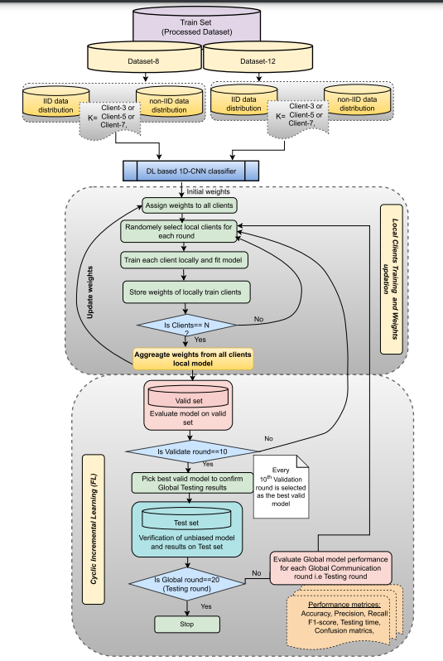
EXISTING SYSTEM
DATASET : CICDDoS2019
Data Distribution: Different computers (clients) have network data, some labeled as attacks and some as normal activity. This data can be IID (independent and identically distributed) or non-IID (skewed, imbalanced).
Model Training: Each client trains a 1D-CNN (Deep Learning Model) on its local data. It then sends the updated model weights (not raw data) to the central server.
Model Aggregation: The server collects all client models and averages the weights to create a better global model. This repeats for multiple rounds.
Intrusion Detection: The final model is tested on new network traffic to classify whether it’s a normal request or an intrusion (attack).

Slide 4
PROPOSED SYSTEM
DATASET: N-BaIoT (Network-Based IoT) dataset
Labeled & Unlabeled Data: Some clients have labeled attack data while others only have unlabeled network traffic. This system uses a discriminator model to separate reliable from unreliable labels.
Step-by-Step Process:
Step 1: Clients train a local classifier on their labeled data.
Step 2: The classifier makes predictions on new, unlabeled data.
Step 3: A discriminator checks whether the prediction is confident enough or should be filtered out.
Step 4: Only the most reliable labels are sent to the central server.
Step 5: The server aggregates these trusted labels and trains a better intrusion detection model.
Intrusion Detection: The final model is tested on real-time network traffic with high accuracy since it learns only from trusted data.

Slide 5
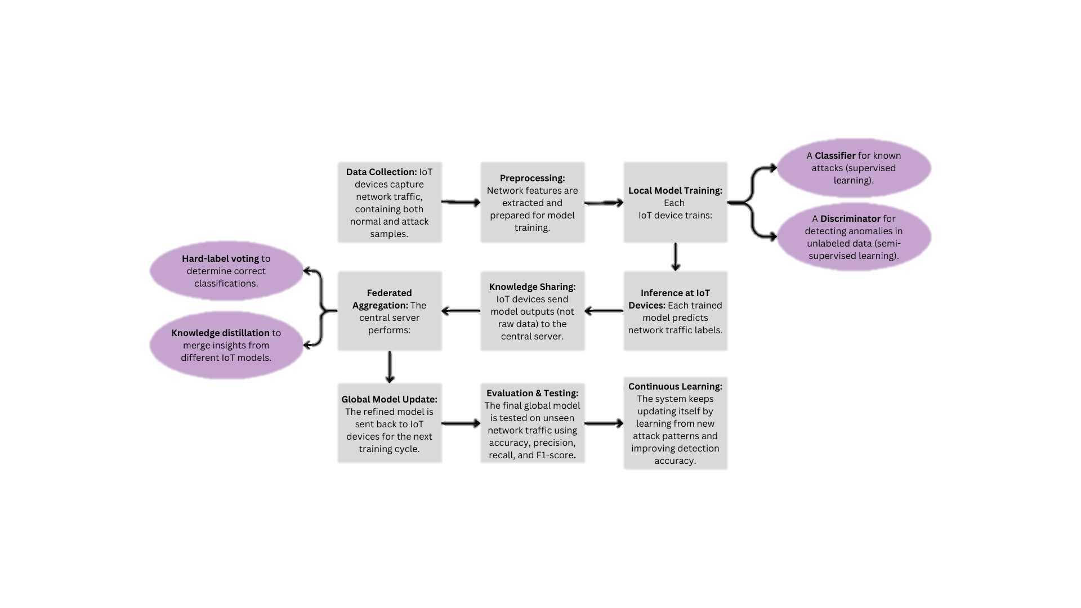
WORKFLOW

Slide 6
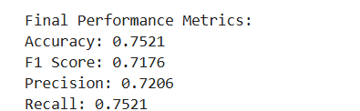
RESULT
CONCLUSION
In this project, we implemented a Semi-Supervised Federated Learning-based Intrusion Detection System (SSFL-IDS) for the N-BaIoT dataset. The system successfully performed distributed learning across multiple IoT devices, leveraging both labeled and unlabeled data to improve detection capabilities.
Our final model achieved an accuracy of 75.21%, with an F1 score of 71.76%, indicating a balanced trade-off between precision and recall. The results demonstrate that the system can effectively identify network intrusions, making it a viable solution for IoT security. However, further optimization—such as hyperparameter tuning, feature engineering, and more advanced model architectures—could enhance its performance.
Overall, this project highlights the potential of federated learning in intrusion detection, reducing dependency on centralized data while preserving privacy and scalability. Future work could focus on improving generalization across different IoT environments and integrating real-time threat adaptation mechanisms.
INFERENCE
The model performs reasonably well but can be improved with hyperparameter tuning, better feature extraction, and more training rounds.
If security is a priority, improving recall should be a focus to reduce false negatives (missed attacks).
If reducing false alarms is the goal, improving precision is necessary to minimize false positives (benign traffic classified as attacks).

